Slide 1
Working with the Media
Media Relations 101
Presented By:
Kelly Loussedes
NABIP’s SVP of Public Relations

Slide 2
Value of Media Relations
What Can Media Outreach Do?
Project a positive image about our industry
Generate understanding of role in healthcare
Educate public about insurance
Identify NABIP members as a source of information
Provide balanced commentary
Advance legislative agenda

Slide 3
Media Relations Overview
Now that I’m a new media chair what do I do??
First and foremost…don’t panic!
Media Tools section of the NABIP website will be your new best friend.
Specific job descriptions for each type of media chair.
Tools and guidebooks to help you do your job.
Conduct “Working with the Media” webinars.

Slide 4
Media Relations Chair
The Media Relations Chair coordinates media activity within the chapter. The Media Relations Chair does NOT need to be a “spokesperson” but does need to coordinate the communication between the “spokesperson” and media.
Identify media outlets and reporters in the area using local, state and NABIP resources
Identify MR spokespersons on specific issues
Monitor media outlets daily
Establish relationships with local reporters
Respond to media requests for information and interviews
Prepare and submit press releases, media advisories, and editorials with the approval of your local and state leaders

Slide 5
Media
Relations
Roles
Media Coordinator/Media Chair
Media Spokesperson
Media “Journalist”

Slide 6
Media Spokesperson
The Media Spokesperson needs broad general knowledge of our issues and typically is the “go-to” person for broadcast media outlets.
Identify yourself as a local or state media spokesperson
“Speak With One Voice”
Establish relationships with local media
Respond to reporter requests for information and interviews
Respond to MR Chair/Coordinator requests

Slide 7
Media Relations “Journalist”
A member with expertise in a specific area, willing to write and submit Editorials and serve as a resource for the Media Chair.
Identify yourself as a local, state or NABIP Media Journalist, and about which topics you can write about
Utilize NABIP’s MR tools and resources to help draft articles and Op-Ed pieces
Coordinate with Media Spokesperson, MR Coordinator and NABIP staff to “Speak With One Voice”
Forward articles to local and state awards chairs

Slide 8
NABIP Media Relations Tools
Media Relations Tools on Website
Multiple media guidebooks
Press release templates
List of canned editorials
PowerPoint presentations on media relations
FREE ads
FREE radio PSAs
Talking Points/Sound Bytes
So much more … !

Slide 9
Media Relations Guidebooks
“How To” Media Guide
Health Insurance Awareness Week Guide
Guide to Buying Media
Guide to Planning a Press Conference
Social Media Guide
Branding Booklet

Slide 10
NABIP Tools on the Web
The place to start:
NABIP Homepage
Chapter Resource Tab
Media Tools & Social Media Tools

Slide 11
Nuts and Bolts of Media Relations Know Your Local Media
Types of Media
Print – daily and weekly newspapers, trade publications and magazines
Broadcast – radio and TV
Social Media – online communication channels
Be a Media Monitor!

Slide 12
Distinctions Between Print and Broadcast Media
Print
Allows more in-depth coverage
Often more lead-time
Great range of venues
Broadcast
Sound bites – message must be more concise
Must have experienced spokesperson

Slide 13
Building Relationships with the Media
Where do I start?
Upon request, we will search a national media database to find reporters and editors in your area. We will send you:
Print media list
Broadcast media list
Sample letter of introduction

Slide 14
Building Relationships with Media
Make First Contact!
Contact a reporter by:
Sending an email
Making a phone call
Introducing yourself at an event
Have a specific purpose!
Don’t:
Send snail-mail or fax
Just “drop by”
Let several months go by without contact

Slide 15
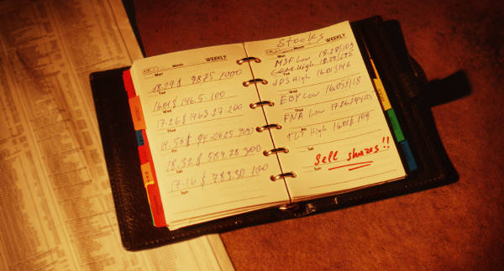
Building Relationships with Media
Keep Press Lists Current
Newspapers have always had a high turnover rate, and it’s only getting worse.
Pay attention to bylines: Who is writing about insurance/healthcare reform?
Look out for local blogs, newsletters and forums.

Slide 16
Building Relationships with Media
First Step – Write a letter of introduction
A “letter of introduction” establishes your professional credentials and invites the reporter to call on you as a resource.
Your email should be brief and to the point, including such things as your professional background, the topics/issues you are prepared to discuss and how you can be reached.
Within a couple days of sending the email, you should follow-up with a personal phone call to make certain the email was received and to reinforce your offer to be contacted as a resource.

Slide 17
Building Relationships with Media
Establish yourself as an expert

Slide 18
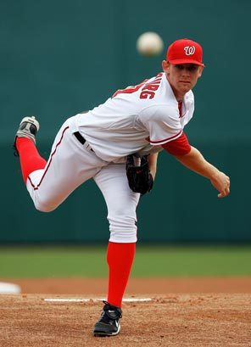
Building Relationships with Media
What do you know that everyone else should too?
When pitching a story idea, make sure your proposal is:
Local
Timely
Unique
Personal/Relatable

Slide 19
Content – Message Management
Localize story or issue
Refer to local people and how issue will affect them and local businesses
Use quotes from local people about the story
Craft meaningful, short messages with relevance to community
Tell why it is relevant with facts/statistics and tangible examples

Slide 20
When and How to Use the Tools
Media Advisory - Announces an upcoming news event or offers a resource person to address a current “hot” issue
Include an eye-catching “headline”
Distribute several days in advance of the news event
Use a “Who, What, When, Where, Why” format
Bullet the main points
Provide contact information and date

Slide 21
When and How to Use the Tools
Media Advisory - Announces an upcoming news event or offers a resource person to address a current “hot” issue
Include an eye-catching “headline”
Distribute several days in advance of the news event
Use a “Who, What, When, Where, Why” format
Bullet the main points
Provide contact information and date

Slide 22
When and How to Use the Tools
Letter to the Editor - Responds to an article or editorial that has appeared in a publication
Make certain it relates directly to the topic
Include name of article, date and page for reference
Be concise and brief (usually 100-200 words)
Share your unique perspective
Give examples
Close with your name, title and affiliation
(Advance Chapter approval required if identified)

Slide 23
When and How to Use the Tools
Op-Ed - An “opinion piece” submitted by an individual or on behalf of an organization to a publication. Placement can be paid for or a publication may decide to publish on its own.
Needs to be linked to a topical issue of interest.
Offers a unique perspective.
Is brief (usually 300-600 words).
Includes name of author and affiliation.

Slide 24
Opportunities For Visibility
Chapter News
Feature Material
National News
Legislative Activities
“Day on the Hill”
Meeting with Governor or Legislators
Awards, Member Professional Achievements
Charitable Activities
Speaking Engagements
Public Hearings
Client Feature Stories
Consumer Tips or Advice
Reaction
Local Impact

Slide 25
Speakers Bureau
The Speakers Bureau Database is comprised of NABIP members who are experts on important NABIP issues.
https://nabip.org/professional-development/speakers-bureau

Slide 26
Media Militia
Seasoned NABIP Spokespeople
Speak with One Voice…Always!
Be Proactive, Don’t Wait for a Phone Call
Product Knowledge, Know the Issue

Slide 27
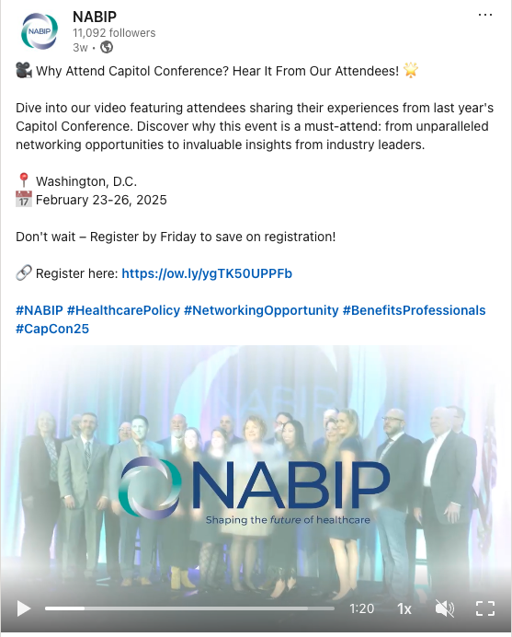
Social Media
Twitter – @nabipsocial
Facebook – National Association of Benefits and Insurance Professionals - NABIP
LinkedIn – NABIP
Instagram – nabipsocial
Sample posts from social media campaigns:
This week, hundreds of agents and brokers will attend #CapCon2025 to discuss ways to boost Americans' access to affordable health insurance that meets their needs. Follow along @nabipsocial! #NABIP
Follow @nabipsocial and #CapCon2025 for updates during this year's exciting event to advocate for #agents and #brokers!

Slide 28
Health Industry Heavyweight

Slide 29
Media Relations Award
Winners will be selected for their outstanding media relations activities at the chapter level.
Media Relations committee in place
Press list of local media contacts
Sending press releases
Publication of Op-Eds and other editorials
Prints and broadcast press hits
Keeping NABIP informed on press exposure
Attend “Working with the Media” webinars
Social Media Engagement

Slide 30
Questions?
Kelly Loussedes
SVP of Public Relations
202-595-3074
kloussedes@nabip.org

