Slide 1
Presented by The NABIP Diversity, Equity & Inclusion Taskforce

Slide 2
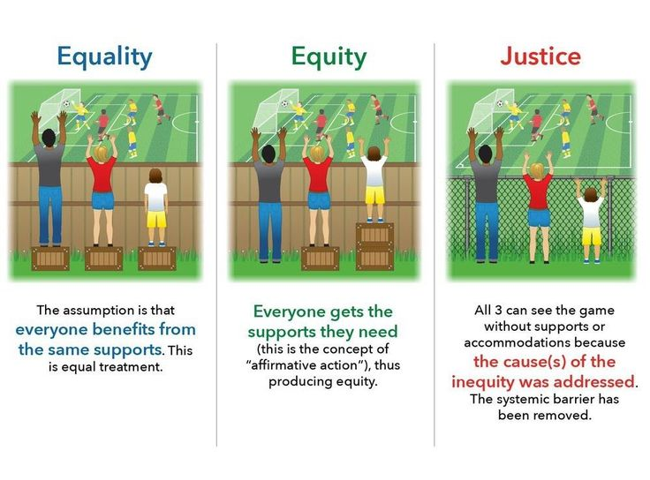

Slide 4
NABIP Diversity, Equity , and Inclusion Mission
To provide Diversity, Equity and Inclusion (DEI) experiences that actively engage us in learning from each other to mitigate unconscious bias, educate on racial injustice, exclude discrimination of all forms, increase equity, and foster inclusion throughout the National Association of Benefits and Insurance Professionals (NABIP).
Vision & Core Values
Leverage the diversity of our membership to reflect the communities we serve, as well as the products and services we deliver
Align policies, practices, programming, resources so all members have opportunities to thrive
Create an environment in which everyone feels valued and respected

Slide 5
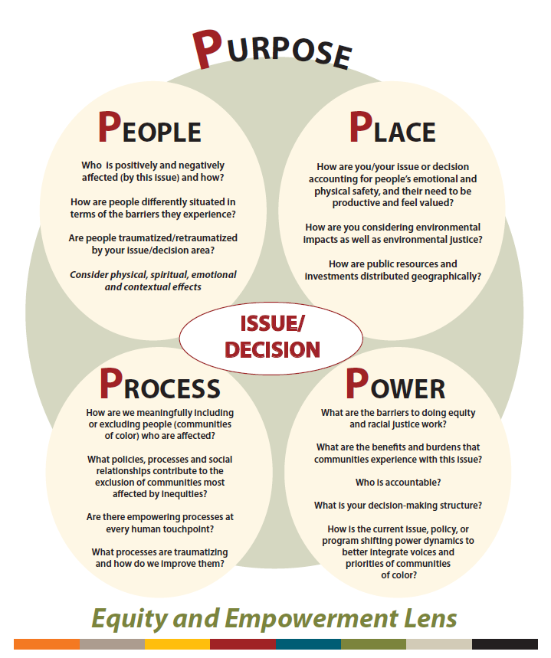

Slide 6
NABIP Diversity, Equity and Inclusion Oversight Committee Roster
Kevin Trokey, Chair
Jeanna Gutierrez, Vice-Chair
Joana Ames
Lee Bethel
Kareim Cade
Valerie Cramer
Kathy Conley-Jones
Kathy Ferguson
Wayne Guzman
Charlotte Horsman
Jalyn Jones
Elizabeth Ortolani
Esther Powers
Guy Stubbs
Michele Thornton
Cinnamon Trimpey
Hetal Vora
Tamalyn Wandler
Alycia Riedl - Board Liaison

